Slide 1


Predicting Customer Turnover
Vivian Dang and Joe Buzzelli
April 17, 2020

Slide 2
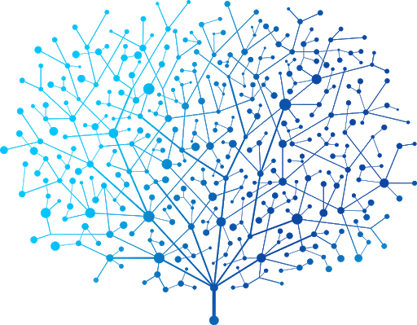
Machine learning empowers Syriatel to mitigate customer turnover
Customer turnover risks Syriatel’s profitibility
After developing our statistical model, we succeeded our goal of predicting customer churn with greater than 95% precision

Slide 3
Assumptions and data sources
Assumptions
All customers received similar products or services
No time period is provided for this data, it is assumed that Syriatel can take actions to improve customer retention
Data sources
Syriatel’s customer turnover data set, no dates provided

Slide 4
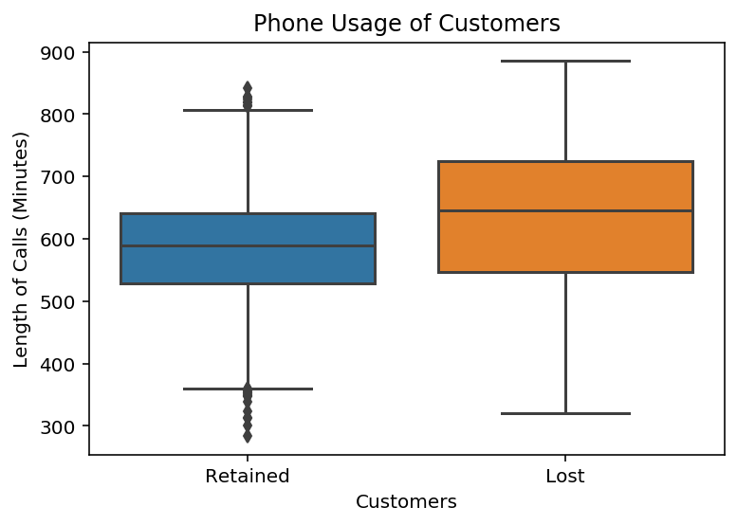
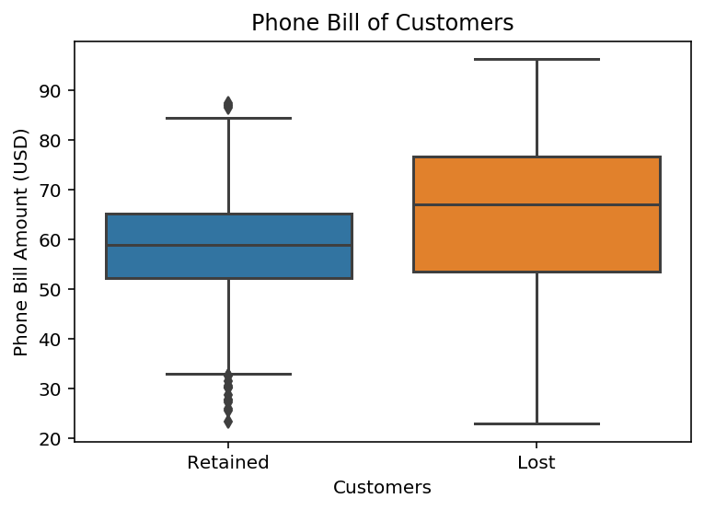
Lost customers incurred higher charges and talked longer
Lost customers have higher total charges and use more minutes than their counterparts
Extra talk yields higher total charges exhibited by lost customers

Slide 5
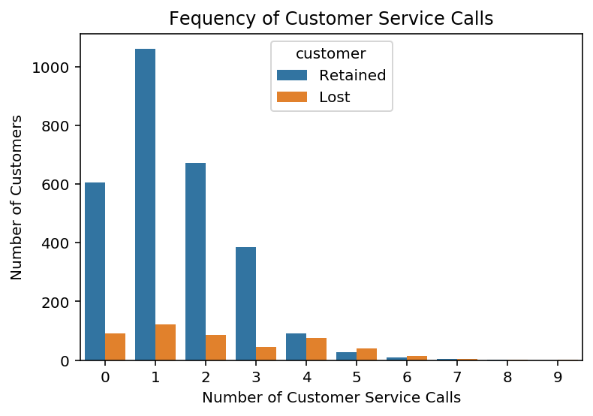
Syriatel appears likely to lose frequent customer service callers
Despite representing only 14% of Syriatel’s customer base, lost customers call customer service disproportionally more often

Slide 6


We deployed the “Goldilocks” approach to find the right model
In an iterative fashion, we assessed several different models until we found the best match with Syriatel’s customer data
This is similar to…

Slide 7


If our model was an archer…

Slide 8
The data identifies three key factors for customer turnover
Total bill
Customers paying over $60 are more likely to turnover
Total minutes
Customers using over 600 minutes are more likely to turnover
Customer service calls
Lost customers typically place more than 4 calls

Slide 9
Monitor customers that use over 600 minutes with a bill over $60
Offer promotions to customers who have made over four customer service calls
Provide a survey to customers when they leave to augment existing data
Recommendations

Slide 10
Improve the current model with additional data from Syriatel to better predict customer turnover
Explore machine learning solutions for Sytriatel’s customer service department to mitigate customer attrition
Conduct a sentiment analysis of Syriatel’s customers to discover issues not present in operational databases
Next Steps

Slide 11

Thank you for your time.
Are there any questions?

Slide 12
Backup Slides

Slide 13
We aimed to maximize precision scores in our models
Precision calculation:
True Positives
÷
True Positives + False Negatives

Slide 14
In total, we used nine different models in this project
Models include:
Gradient Boosting Classifier
Default and tuned
Random Forest
Default and tuned
Logistic Regression cross validation estimator
Default and tuned
Nearest neighbor (KNN)
Default and tuned
Decision tree

Slide 15
For each model type, the best performer was tested
The table below outlines the best performing models per type:
Best Model by Type | Precision | Accuracy | Recall | F1
Gradient Boosting Classifier | 0.970 | 0.980 | 0.890 | 0.928
KNN (n=7) | 0.925 | 0.900 | 0.338 | 0.495
Random Forest | 0.977 | 0.981 | 0.890 | 0.931
Decision Tree (max_depth = 1) | 0.970 | 0.917 | 0.441 | 0.607
Logistic Regression (solver = 'lbfgs', Cs=50, penalty='l2') | 0.528 | 0.857 | 0.131 | 0.210

Slide 16
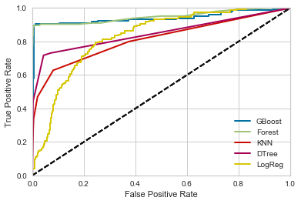
ROC Curves for each tested model
The chart below includes the ROC curve for each model vs the test data

Slide 17
Random Forest Notes
Strengths
RFs train each tree independently, using a random sample of the data. This randomness helps to make the model more robust than a single decision tree, and less likely to overfit on the training data -> one of the most accurate learning algorithms available
RF is much easier to tune than GBM. There are typically two parameters in RF: number of trees and number of features to be selected at each node.
RF is harder to overfit than GBM
Weaknesses
Overfit for some datasets with noisy classification/regression tasks
Classifications made by random forests are difficult for humans to interpret
Categorical variables with different number of levels, random forests are biased in favor of those attributes with more levels
Default parameters
Default: (n_estimators=100, criterion='gini', max_depth=None, min_samples_split=2, min_samples_leaf=1, min_weight_fraction_leaf=0.0, max_features='auto', max_leaf_nodes=None, min_impurity_decrease=0.0, min_impurity_split=None, bootstrap=True, oob_score=False, n_jobs=None, random_state=None, verbose=0, warm_start=False, class_weight=None, ccp_alpha=0.0, max_samples=None

Slide 18
Gradient Boosting Classifier
Strengths
Build trees one at a time, where each new tree helps to correct errors made by previously trained tree.
Great for very unbalanced data
Weaknesses
Sensitive to overfitting if the data is noisy.
Training generally takes longer because of the fact that trees are built sequentially.
Harder to tune than RF. There are typically three parameters: number of trees, depth of trees and learning rate, and each tree built is generally shallow.
Default parameters
(loss='deviance', learning_rate=0.1, n_estimators=100, subsample=1.0, criterion='friedman_mse', min_samples_split=2, min_samples_leaf=1, min_weight_fraction_leaf=0.0, max_depth=3, min_impurity_decrease=0.0, min_impurity_split=None, init=None, random_state=None, max_features=None, verbose=0, max_leaf_nodes=None, warm_start=False, presort='deprecated', validation_fraction=0.1, n_iter_no_change=None, tol=0.0001, ccp_alpha=0.0)

